Slide 1
Subtopic N2.11 – Perimeter of Rectangles and Parallelograms
LEARNING OUTCOME: to solve problems involving the perimeter of rectangles and parallelograms
Keywords:
Distance
Edges
Length
Units
Rectangle
Parallelogram
Objectives:
To find the perimeter of a rectangle or parallelogram
To find missing lengths in a rectangle or parallelogram
Introduction – Read and annotate:
A rectangle and a parallelogram both have opposite sides that are equal in length, which makes
calculating their perimeter easier. Sometimes, you will be given shapes where some side lengths are
missing. You will need to use this fact to find the missing sides before adding to get the perimeter.
Definition
Characteristics
8cm
A 2D shape with four sides and four right angles
The sides opposite each other have equal lengths
To work out the perimeter, add up the lengths of all the sides.
Examples
Rectangle
Non - Examples
Definition
Characteristics
8cm
A 2D shape with four sides and two pairs of parallel sides
The sides opposite each other have equal lengths
The angles opposite each other are equal
Examples
Parallelogram
Non - Examples
Find the perimeter of rectangles
Example 1 - I do…
Example 2 – We do…
Example 3 – You do…
Steps | Find the perimeter: | Find the perimeter: | Find the perimeter:
1. Label all known side lengths
2. Add up all the side lengths to find the perimeter
9 cm
2.9 cm
7cm
4 cm
0.7 cm
0.7 cm
3cm
3cm
4 cm
7cm
9 cm
2.9 m
2.9 cm
20m
26cm
7.2m
0.6 m
4 cm
2.7cm
1.3 m
12 cm
5.8cm
3.8m
32cm
17cm

Slide 2
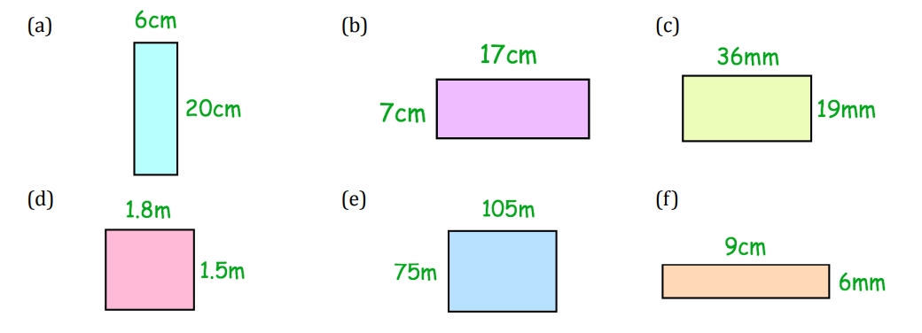
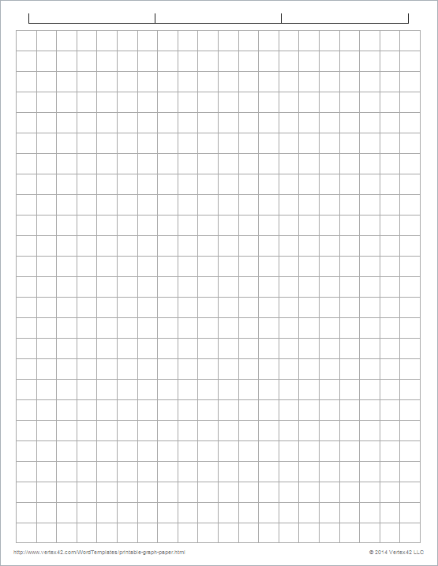
Independent Practice
1. Find the perimeter of the following rectangles:
52cm
48cm
110mm
6.6m
360m
30cm
(g)
6.73cm
(h)
(i)
19.3cm
6.5cm
4.6cm
4.6cm
8.63cm
6.73cm
12cm
22.66cm
41.26cm
51.6cm
2. Draw three different rectangles with a perimeter of 16 squares:

Slide 3
Find the perimeter of parallelograms
Example 4 - I do…
Example 5 – We do…
Example 6 – You do…
Steps | Find the perimeter of the parallelogram: | Find the perimeter of the parallelogram: | Find the perimeter of the parallelogram:
1. Label all known side lengths
2. Add up all the side lengths to find the perimeter
4 m
8 m
3 cm
3 m
2 m
3 m
5 m
5 m
7 cm
7 cm
3 cm
4 m
14m
8 m
26cm
20cm
9 cm
2.2 m
2.8 m
3.1 cm
4.03 cm
6.1 cm
3.5 m
6.7 cm
30.2cm
12.6m
21.46cm
Independent Practice
3. Find the perimeter of the following parallelograms:
(a)
10cm
(b)
(c)
472mm
4cm
4cm
87cm
87cm
651mm
36cm
310mm
10cm
28cm
246cm
2,246mm
(d)
1.8m
(e)
27.6m
(f)
43cm
0.7m
1.58m
1.3 m
1.58m
29cm
27.6m
5m
58.36m
144cm

Slide 4
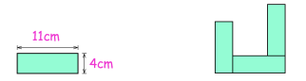
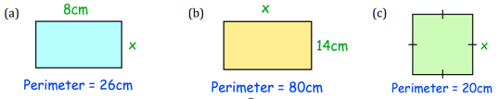
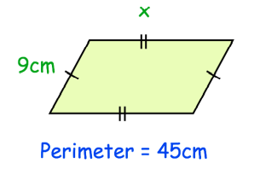
4. How much bigger is the rectangle’s perimeter than the parallelogram’s perimeter?
5. Three congruent rectangles are placed together to make the shape below. Find the perimeter of the shape.
87 cm
245 cm
470 cm
1,114cm
100 cm
118 cm
726cm
longer by 388cm
74cm
Find the length of a missing side in a rectangle or parallelogram
Example 7 - I do…
Example 8 – We do…
Example 9 – You do…
Steps | The perimeter is given. Find the missing length: | The perimeter is given. Find the missing length: | The perimeter is given. Find the missing length:
1. Label all known side lengths
2. Subtract to find the value of twice the missing length
3. Divide by 2 to find missing length
5cm
?
?
?
1.2m
11cm
Perimeter = 36cm
Perimeter = 3.4m
Perimeter = 28cm
13cm
0.5m
3cm
Independent Practice
6. The perimeter of each shape is given. Find the length of the missing side.
(d)
5cm
26cm
5cm
13.5cm

Slide 5
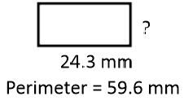
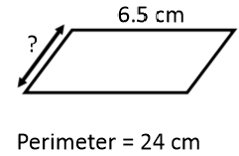
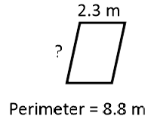
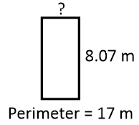
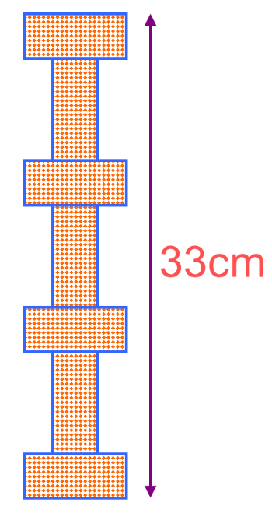

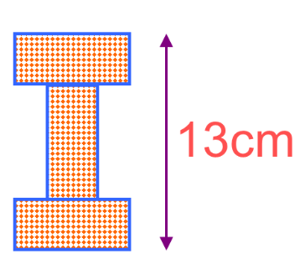
(e) (f) (g) (h)
5.5mm
5.5cm
2.1m
0.43m
7. Using the diagrams below, find the perimeter of one individual rectangle:
8. The width of a rectangle is 2 metres less than the length. The perimeter of the rectangle is between 11 m and 15 m. What could the dimensions of the rectangle be? Give one possible answer. Multiple answers. E.g. If the perimeter is 12 m: Length = 4 m Width = 2 m.
9. A rectangle has a perimeter of 18cm. Write down 5 possible pairs of values for its length and width.
20cm
1cm&8cm, 2cm&7cm, 3cm&6cm, 4cm&5cm, 1.5cm&7.5cm,
Any pair of numbers that sum to 9

Slide 6

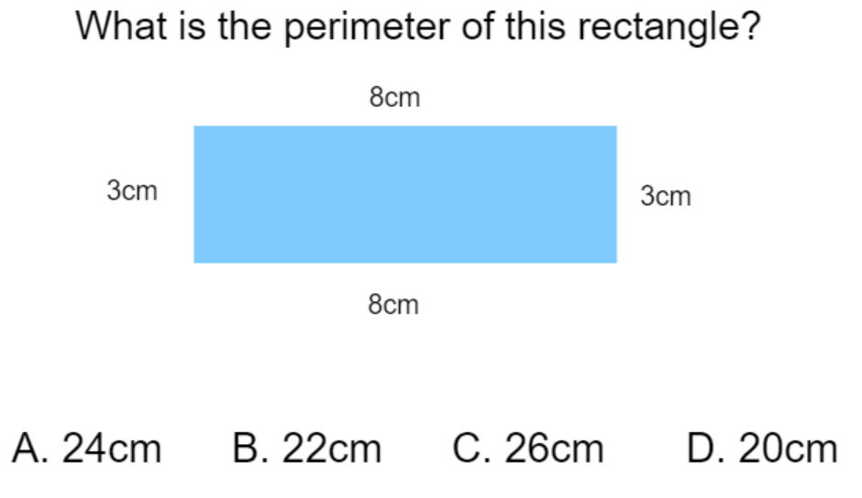
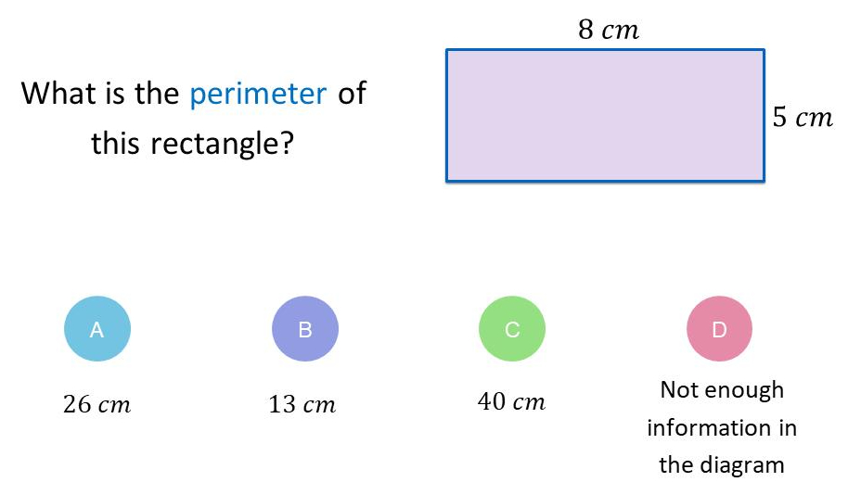
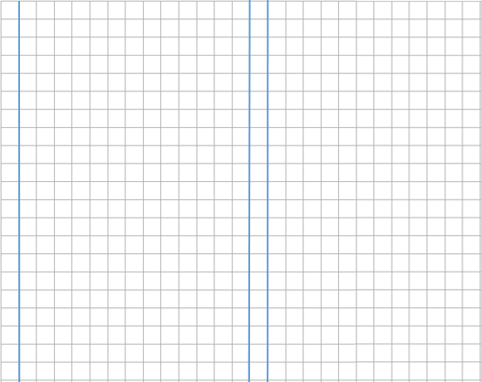
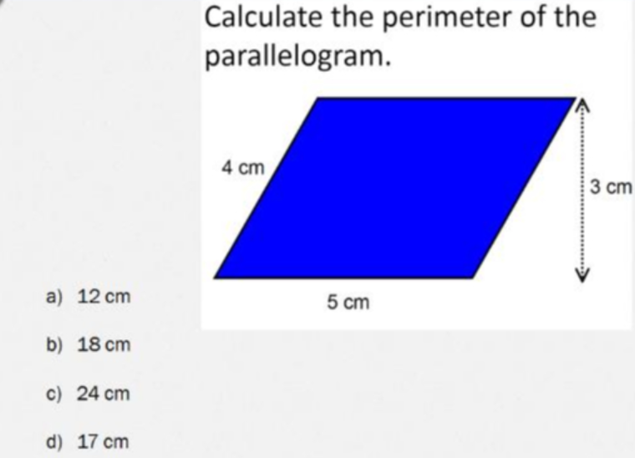
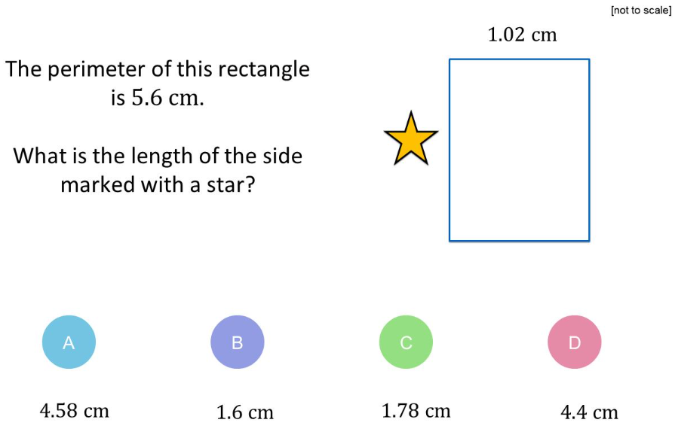
10. The triangle and square have the same perimeter. Find x:
11. The length of a rectangular field is 60m greater that the width of the field.
The field has a length of 310m. Find the perimeter of the field.
12cm
1120m
Skills Check
1. 2.
3. 4.

